Slide 1
Learning & Development Enabling development, Impacting growth…
BIG-
Apache Spark

Slide 2
Spark Core
RDD Basics
Creating RDDs in Spark.
RDD Operations.
Passing Functions to Spark.
Transformations and Actions in Spark
Spark RDD Persistence
Q&A

Slide 3
RDD Basics
Resilient Distributed Dataset
Spark’s primary abstraction
A distributed collection of items called elements, could be KV pairs or anything else
RDDs are immutable
RDDs can contain any type of Python, Java, or Scala objects
Transformations and Actions can be performed on RDDs
RDD can be created from HDFS file, local file, parallelized collection, JSON file etc.

Slide 4
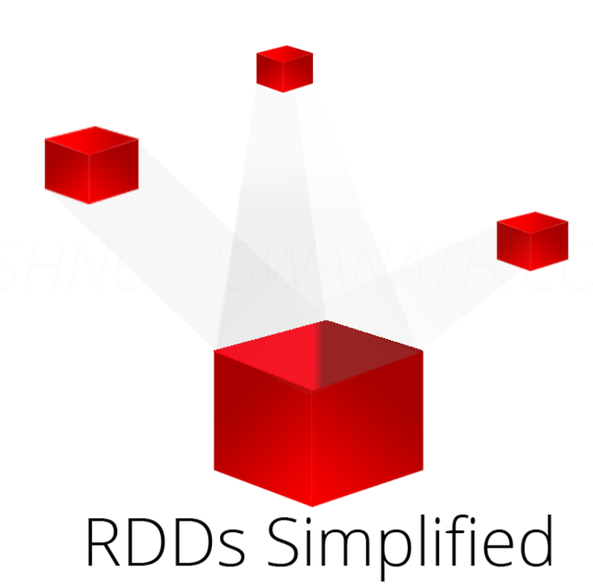
RDD Basics
Data Lineage (What makes RDD resilient?)
RDD has lineage that keep tracks of where data came from and how it was derived
Lineage is stored in the DAG or the driver program
DAG is logical only because the compiler optimizes the DAG for efficiency
Image Source; http://vishnuviswanath.com/img/spark_rdd/blog_header.png

Slide 5
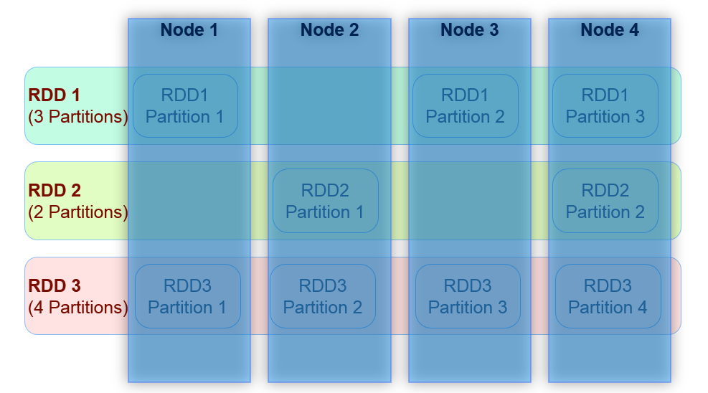
RDD Basics
RDD Internal Representation
Image Source: Datafacts Company

Slide 6
Spark Core
RDD Basics
Creating RDDs in Spark.
RDD Operations.
Passing Functions to Spark.
Transformations and Actions in Spark
Spark RDD Persistence
Q&A

Slide 7
Creating RDDs in Spark.
RDDs can be created in two ways.
Create an RDD from an external file.
Create an RDD from a list of Strings
Below example loads a text file as an RDD.
textFile() method in Python
lines = sc.textFile("/path/to/README.md")
textFile() method in Scala
val lines = sc.textFile("/path/to/README.md")
Notes:
lines = sc.textFile("/path/to/README.md") #python
val lines = sc.textFile("/path/to/README.md") # Scala

Slide 8
Creating RDDs in Spark.
Below example Create an RDD from a list of Strings
It can be created by parallelizing collections in your driver
parallelize() method in Python
lines = sc.parallelize(["pandas", "i like pandas"])
parallelize() method in Scala
val lines = sc.parallelize(List("pandas", "i like pandas"))
Notes:
parallelize() method in Python
lines = sc.parallelize(["pandas", "i like pandas"])
parallelize() method in Scala
val lines = sc.parallelize(List("pandas", "i like pandas"))

Slide 9
Spark Core
RDD Basics
Creating RDDs in Spark.
RDD Operations.
Passing Functions to Spark.
Transformations and Actions in Spark
Spark RDD Persistence
Q&A

Slide 10
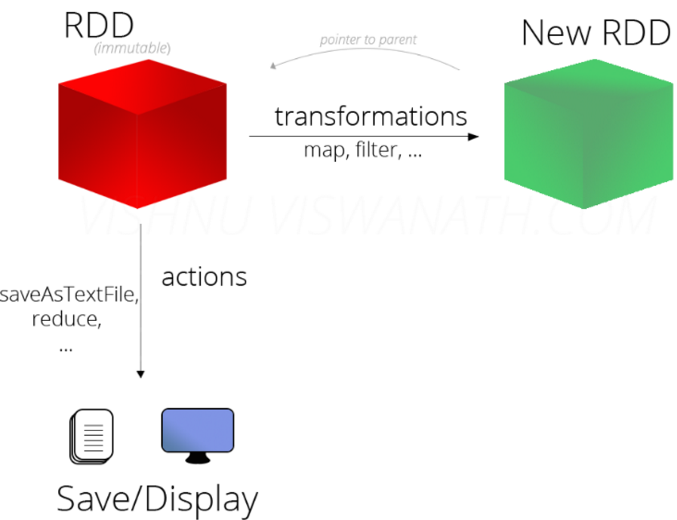
RDD Operations
RDD Operations
Transformations
Actions
Lazy Evaluation
Image Source: http://vishnuviswanath.com/spark_rdd.html

Slide 11
RDD Operations
Transformations:
Operate on an RDD and return a new RDD: Are lazily evaluated
Actions
Return a value after running a computation on a RDD.
The DAG is evaluated only when an action takes place.
Lazy Evaluation
Evaluation happens only when an action is called.
Deferring decisions will yield more information at runtime to better optimize the program
So a Spark program actually starts executing when an action is called.

Slide 12
RDD Operations
Transformations:
Transformations are operations on RDDs that return a new RDD
filter() transformation in Python
inputRDD = sc.textFile("log.txt")
errorsRDD = inputRDD.filter(lambda x: "error" in x)
filter() transformation in Scala
val inputRDD = sc.textFile("log.txt")
val errorsRDD = inputRDD.filter(line => line.contains("error"))
Notes:
Note that the filter() operation does not mutate the existing inputRDD. Instead, it returns a pointer to an entirely new RDD.

Slide 13
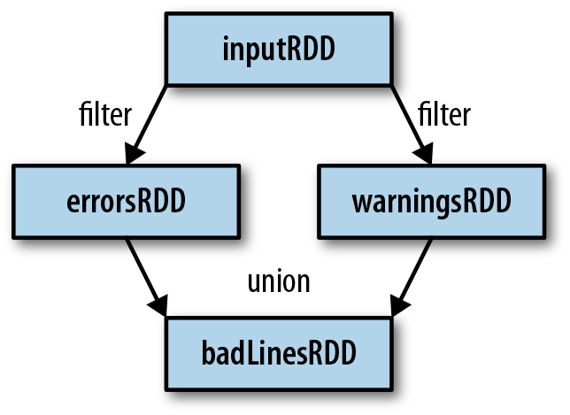
RDD Operations
Transformations: lineage graph
It uses this information to compute each RDD on demand and to recover lost data if part of a persistent RDD is lost
RDD lineage graph created during log analysis
Image Source:LearningSpark(o'reilly media)

Slide 14
RDD Operations
Actions
Operations that return a final value to the driver program or write data to an external storage system
Python error count using actions
print "Input had " + badLinesRDD.count() + " concerning lines"
print "Here are 10 examples:"
for line in badLinesRDD.take(10):
print line
Scala error count using actions
println("Input had " + badLinesRDD.count() + " concerning lines")
println("Here are 10 examples:")
badLinesRDD.take(10).foreach(println)

Slide 15
Spark Core
RDD Basics
Creating RDDs in Spark.
RDD Operations.
Passing Functions to Spark.
Transformations and Actions in Spark
Spark RDD Persistence
Q&A

Slide 16
Passing Functions to Spark
Python
Three options for passing functions into Spark
we can pass in lambda expressions
we can pass in top-level functions
We can pass in locally defined functions.
Passing functions in Python
word = rdd.filter(lambda s: "error" in s)
def containsError(s):
return "error" in s
word = rdd.filter(containsError)

Slide 17
Passing Functions to Spark
Scala
Three options for passing functions into Spark
We can pass in functions defined inline,
We can pass in function References to methods.
Passing functions in Scala
class SearchFunctions(val query: String) {
def isMatch(s: String): Boolean = {
s.contains(query)
}
def getMatchesFunctionReference(rdd: RDD[String]): RDD[String] = {
// Problem: "isMatch" means "this.isMatch", so we pass all of "this"
rdd.map(isMatch)
}}
Notes:
class SearchFunctions(val query: String) {
def isMatch(s: String): Boolean = {
s.contains(query)
}
def getMatchesFunctionReference(rdd: RDD[String]): RDD[String] = {
// Problem: "isMatch" means "this.isMatch", so we pass all of "this"
rdd.map(isMatch)
}
def getMatchesFieldReference(rdd: RDD[String]): RDD[String] = {
// Problem: "query" means "this.query", so we pass all of "this"
rdd.map(x => x.split(query))
}
def getMatchesNoReference(rdd: RDD[String]): RDD[String] = {
// Safe: extract just the field we need into a local variable
val query_ = this.query
rdd.map(x => x.split(query_))
}
}

Slide 18
Spark Core
RDD Basics
Creating RDDs in Spark.
RDD Operations.
Passing Functions to Spark.
Transformations and Actions in Spark
Spark RDD Persistence
Q&A

Slide 19
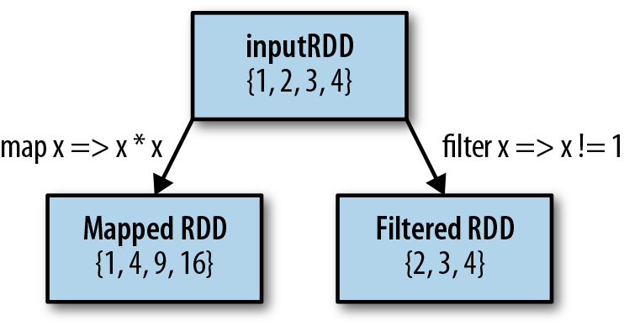
Transformations and Actions in Spark
Transformations
Element-wise transformations: Transformation takes in a function and applies it to each element in the RDD
Map() : map()’s return type does not have to be the same as its input type,
Filter()
Mapped and filtered RDD from an input RDD
Notes:
class SearchFunctions(val query: String) {
def isMatch(s: String): Boolean = {
s.contains(query)
}
def getMatchesFunctionReference(rdd: RDD[String]): RDD[String] = {
// Problem: "isMatch" means "this.isMatch", so we pass all of "this"
rdd.map(isMatch)
}
def getMatchesFieldReference(rdd: RDD[String]): RDD[String] = {
// Problem: "query" means "this.query", so we pass all of "this"
rdd.map(x => x.split(query))
}
def getMatchesNoReference(rdd: RDD[String]): RDD[String] = {
// Safe: extract just the field we need into a local variable
val query_ = this.query
rdd.map(x => x.split(query_))
}
}

Slide 20
Transformations and Actions in Spark
Element-wise transformations: Examples
Python squaring the values in an RDD
nums = sc.parallelize([1, 2, 3, 4])
squared = nums.map(lambda x: x * x).collect()
for num in squared:
print "%i " % (num)
Scala squaring the values in an RDD
val input = sc.parallelize(List(1, 2, 3, 4))
val result = input.map(x => x * x)
println(result.collect().mkString(","))
Notes:
class SearchFunctions(val query: String) {
def isMatch(s: String): Boolean = {
s.contains(query)
}
def getMatchesFunctionReference(rdd: RDD[String]): RDD[String] = {
// Problem: "isMatch" means "this.isMatch", so we pass all of "this"
rdd.map(isMatch)
}
def getMatchesFieldReference(rdd: RDD[String]): RDD[String] = {
// Problem: "query" means "this.query", so we pass all of "this"
rdd.map(x => x.split(query))
}
def getMatchesNoReference(rdd: RDD[String]): RDD[String] = {
// Safe: extract just the field we need into a local variable
val query_ = this.query
rdd.map(x => x.split(query_))
}
}

Slide 21
Transformations and Actions in Spark
flatMap() : Splitting up an input string into words
flatMap() in Python, splitting lines into words
lines = sc.parallelize(["hello world", "hi"])
words = lines.flatMap(lambda line: line.split(" "))
words.first() # returns "hello"
flatMap() in Scala, splitting lines into multiple words
val lines = sc.parallelize(List("hello world", "hi"))
val words = lines.flatMap(line => line.split(" "))
words.first() // returns "hello"
Notes:
class SearchFunctions(val query: String) {
def isMatch(s: String): Boolean = {
s.contains(query)
}
def getMatchesFunctionReference(rdd: RDD[String]): RDD[String] = {
// Problem: "isMatch" means "this.isMatch", so we pass all of "this"
rdd.map(isMatch)
}
def getMatchesFieldReference(rdd: RDD[String]): RDD[String] = {
// Problem: "query" means "this.query", so we pass all of "this"
rdd.map(x => x.split(query))
}
def getMatchesNoReference(rdd: RDD[String]): RDD[String] = {
// Safe: extract just the field we need into a local variable
val query_ = this.query
rdd.map(x => x.split(query_))
}
}

Slide 22
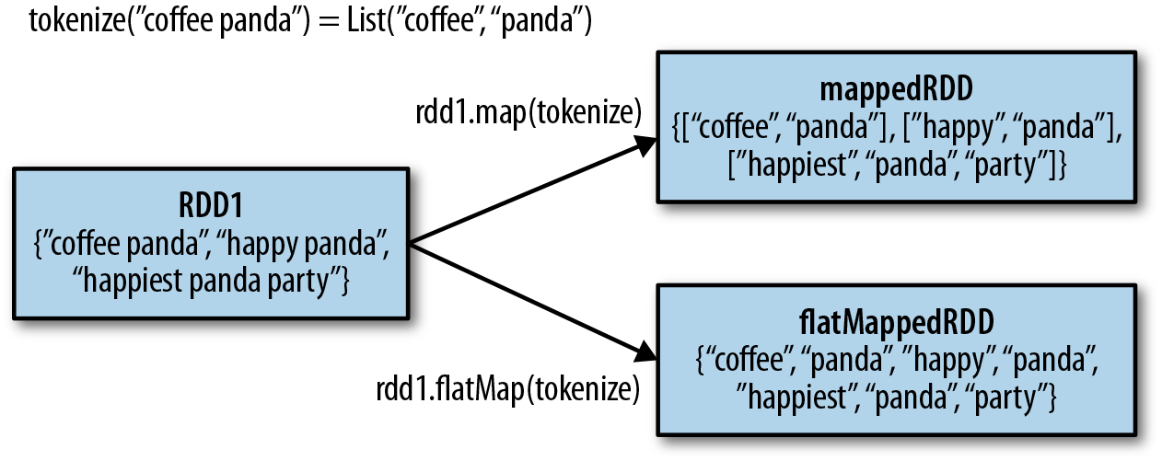
Transformations and Actions in Spark
Difference between flatMap() and map() on an RDD
Image Source:LearningSpark(o'reilly media)
Notes:
class SearchFunctions(val query: String) {
def isMatch(s: String): Boolean = {
s.contains(query)
}
def getMatchesFunctionReference(rdd: RDD[String]): RDD[String] = {
// Problem: "isMatch" means "this.isMatch", so we pass all of "this"
rdd.map(isMatch)
}
def getMatchesFieldReference(rdd: RDD[String]): RDD[String] = {
// Problem: "query" means "this.query", so we pass all of "this"
rdd.map(x => x.split(query))
}
def getMatchesNoReference(rdd: RDD[String]): RDD[String] = {
// Safe: extract just the field we need into a local variable
val query_ = this.query
rdd.map(x => x.split(query_))
}
}

Slide 23
Transformations and Actions in Spark
Actions
The most common action on basic RDDs you will likely use is reduce()
reduce() in Python
sum = rdd.reduce(lambda x, y: x + y)
reduce() in Scala
val sum = rdd.reduce((x, y) => x + y)
Notes:
class SearchFunctions(val query: String) {
def isMatch(s: String): Boolean = {
s.contains(query)
}
def getMatchesFunctionReference(rdd: RDD[String]): RDD[String] = {
// Problem: "isMatch" means "this.isMatch", so we pass all of "this"
rdd.map(isMatch)
}
def getMatchesFieldReference(rdd: RDD[String]): RDD[String] = {
// Problem: "query" means "this.query", so we pass all of "this"
rdd.map(x => x.split(query))
}
def getMatchesNoReference(rdd: RDD[String]): RDD[String] = {
// Safe: extract just the field we need into a local variable
val query_ = this.query
rdd.map(x => x.split(query_))
}
}

Slide 24
Transformations and Actions in Spark
Both fold() and reduce() require that the return type of our result be the same type
aggregate() : Compute the average of an RDD
aggregate() in Python
sumCount = nums.aggregate((0, 0),
(lambda acc, value: (acc[0] + value, acc[1] + 1),
(lambda acc1, acc2: (acc1[0] + acc2[0], acc1[1] + acc2[1]))))
return sumCount[0] / float(sumCount[1])
aggregate() in Scala
val result = input.aggregate((0, 0))(
(acc, value) => (acc._1 + value, acc._2 + 1),
(acc1, acc2) => (acc1._1 + acc2._1, acc1._2 + acc2._2))
val avg = result._1 / result._2.toDouble
Notes:
class SearchFunctions(val query: String) {
def isMatch(s: String): Boolean = {
s.contains(query)
}
def getMatchesFunctionReference(rdd: RDD[String]): RDD[String] = {
// Problem: "isMatch" means "this.isMatch", so we pass all of "this"
rdd.map(isMatch)
}
def getMatchesFieldReference(rdd: RDD[String]): RDD[String] = {
// Problem: "query" means "this.query", so we pass all of "this"
rdd.map(x => x.split(query))
}
def getMatchesNoReference(rdd: RDD[String]): RDD[String] = {
// Safe: extract just the field we need into a local variable
val query_ = this.query
rdd.map(x => x.split(query_))
}
}

Slide 25
Transformations and Actions in Spark
Spark Operations
Transformations (define a new RDD) | Map() filter() Sample() groupByKey() reduceByKey() sortByKey() flatMap() union() join() cogroup() cross mapValues()
Actions (return a result to driver program) | Collect() Reduce() Count() Save() lookupKey()
Notes:
class SearchFunctions(val query: String) {
def isMatch(s: String): Boolean = {
s.contains(query)
}
def getMatchesFunctionReference(rdd: RDD[String]): RDD[String] = {
// Problem: "isMatch" means "this.isMatch", so we pass all of "this"
rdd.map(isMatch)
}
def getMatchesFieldReference(rdd: RDD[String]): RDD[String] = {
// Problem: "query" means "this.query", so we pass all of "this"
rdd.map(x => x.split(query))
}
def getMatchesNoReference(rdd: RDD[String]): RDD[String] = {
// Safe: extract just the field we need into a local variable
val query_ = this.query
rdd.map(x => x.split(query_))
}
}

Slide 26
Spark Core
RDD Basics
Creating RDDs in Spark.
RDD Operations.
Passing Functions to Spark.
Transformations and Actions in Spark
Spark RDD Persistence
Q&A

Slide 27
Spark RDD Persistence
Persistence (caching)
Nodes that compute the RDD store their partitions
If a node that has data persisted on it fails, Spark will recompute the lost partitions of the data when needed.
In Scala, the default persist() will store the data in the JVM heap as unserialized objects.
In Python, we always serialize the data that persist stores.
When we write data out to disk or off-heap storage, that data is also always serialized.
Notes:
class SearchFunctions(val query: String) {
def isMatch(s: String): Boolean = {
s.contains(query)
}
def getMatchesFunctionReference(rdd: RDD[String]): RDD[String] = {
// Problem: "isMatch" means "this.isMatch", so we pass all of "this"
rdd.map(isMatch)
}
def getMatchesFieldReference(rdd: RDD[String]): RDD[String] = {
// Problem: "query" means "this.query", so we pass all of "this"
rdd.map(x => x.split(query))
}
def getMatchesNoReference(rdd: RDD[String]): RDD[String] = {
// Safe: extract just the field we need into a local variable
val query_ = this.query
rdd.map(x => x.split(query_))
}
}

Slide 28
Spark RDD Persistence
persist() in Scala
val result = input.map(x => x * x)
result.persist(StorageLevel.DISK_ONLY)
println(result.count())
println(result.collect().mkString(","))
We called persist() on the RDD before the first action
The persist() call on its own doesn’t force evaluation.
Spark will automatically evict old partitions using a Least Recently Used (LRU) cache policy.
unpersist() that lets you manually remove them from the cache.
Notes:
class SearchFunctions(val query: String) {
def isMatch(s: String): Boolean = {
s.contains(query)
}
def getMatchesFunctionReference(rdd: RDD[String]): RDD[String] = {
// Problem: "isMatch" means "this.isMatch", so we pass all of "this"
rdd.map(isMatch)
}
def getMatchesFieldReference(rdd: RDD[String]): RDD[String] = {
// Problem: "query" means "this.query", so we pass all of "this"
rdd.map(x => x.split(query))
}
def getMatchesNoReference(rdd: RDD[String]): RDD[String] = {
// Safe: extract just the field we need into a local variable
val query_ = this.query
rdd.map(x => x.split(query_))
}
}

Slide 29
Q & A

Slide 30
Thank You
Review Date | 13-May-2016
Version | 1.0
Next Review Due | 13-May-2016

